Slide 1
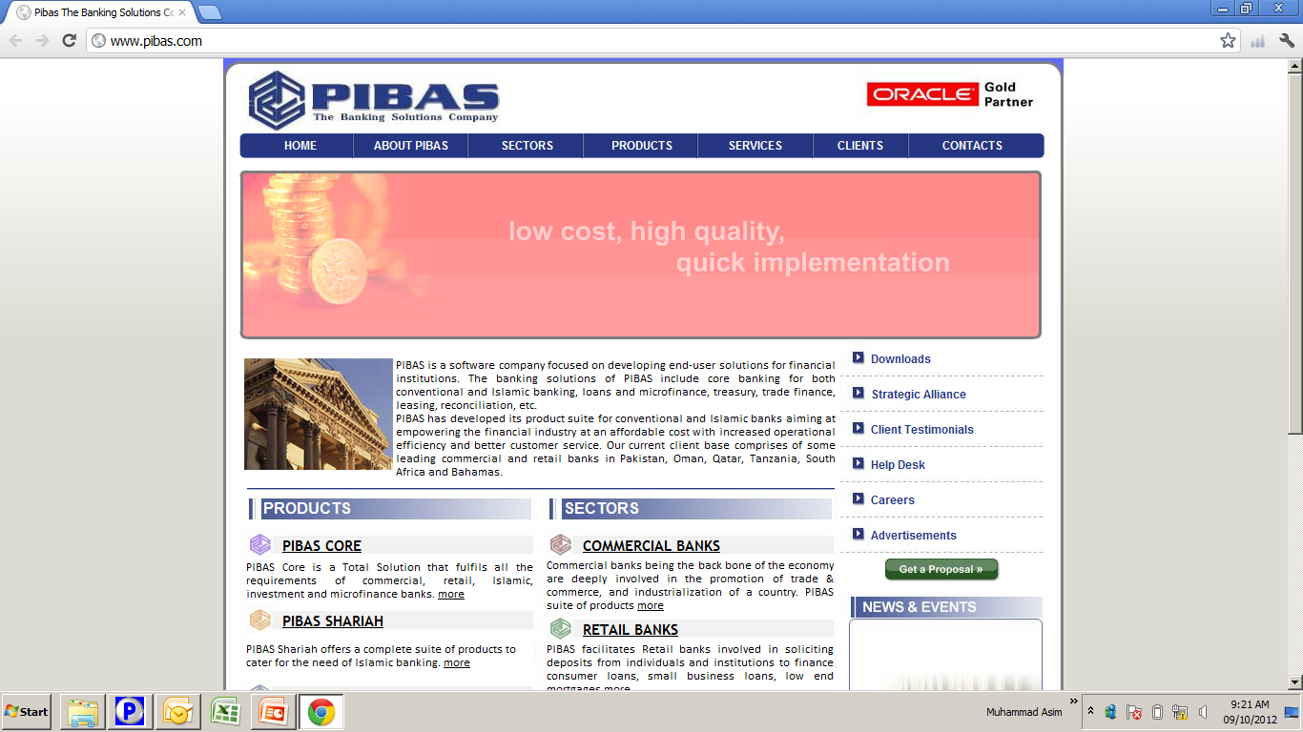
Outward Remittances
Outward Remittances

Slide 2
Contents
Outward Remittances
Pay Order (PO)
Demand Draft (DD)
Pay Order / Demand Draft …. Maintenance
Correspondent Bank Branch Parameters
Remittance Parameter Maintenance
Remittance Stock Control Maintenance
Remittance Period Wise Report
Remittance Supervision
Today’s Remittance Detail

Slide 3
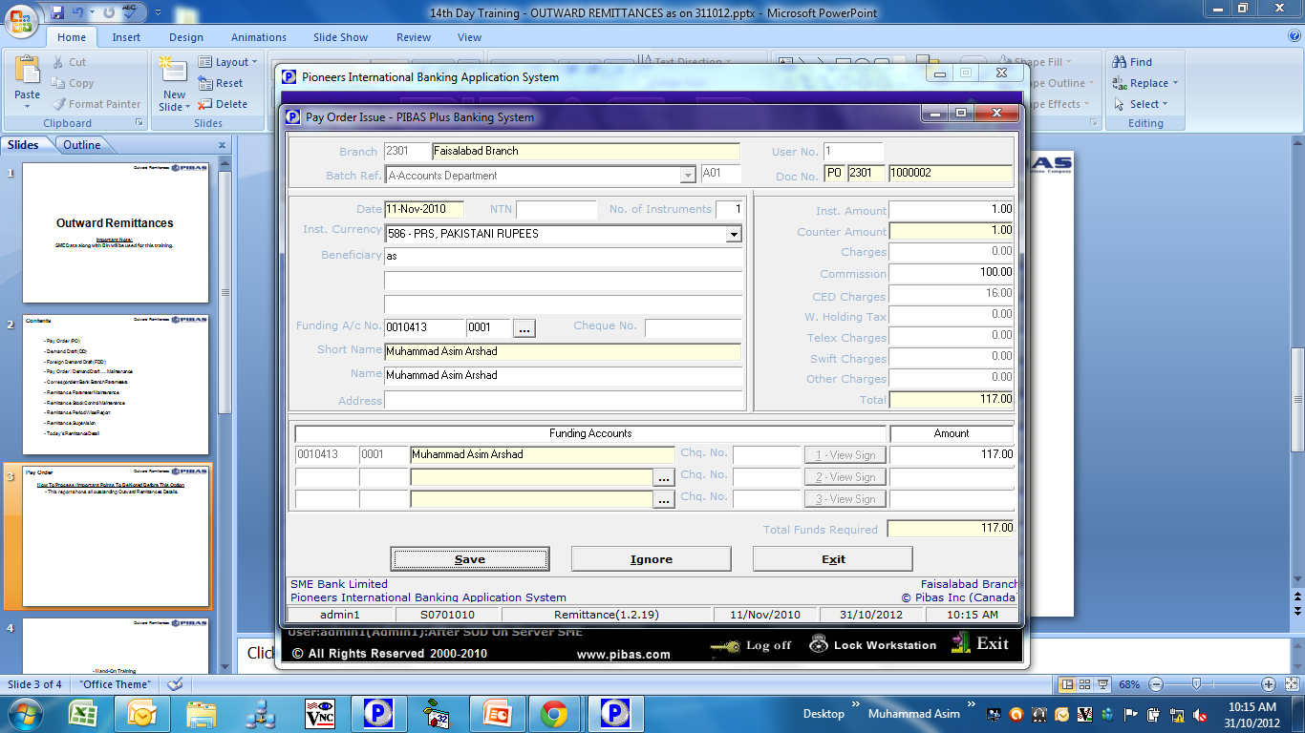
Outward Remittances
Pay Order (PO)
How To Process / Important Points To Be Noted Before This Option
Pay Order can be issued on behalf of customer and bank as well.
Any funding account may be used as per instructions / approval
Default Charges can also be removed / reduced as per schedule of charges of bank
In this screen pay order will be issued in system but will be printed at Supervision Level

Slide 4
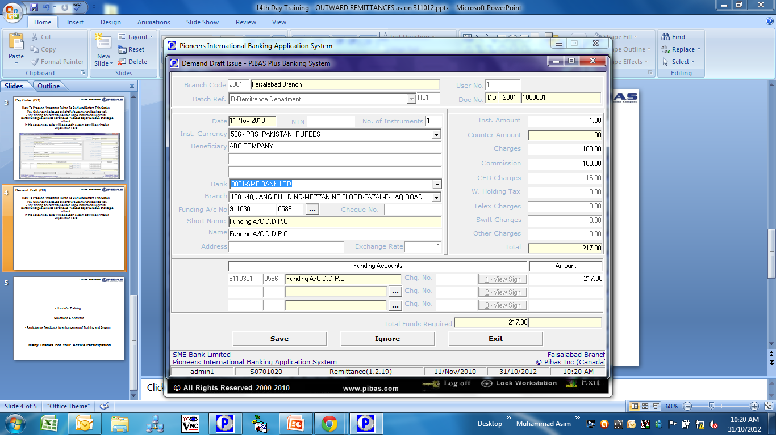
Outward Remittances
Demand Draft (DD)
How To Process / Important Points To Be Noted Before This Option
Demand Draft can be issued on behalf of customer and bank as well.
Any funding account may be used as per instructions / approval
Default Charges can also be removed / reduced as per schedule of charges of bank
In this screen Demand Draft will be issued in system but will be printed at Supervision Level
Drawn On Bank / Branch is very important in case of Demand Draft Issuance

Slide 5
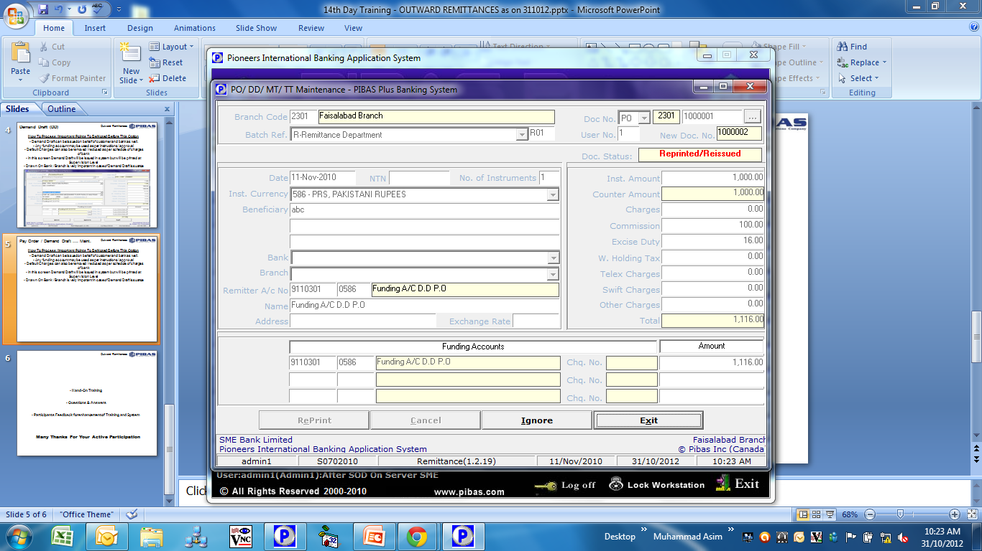
Outward Remittances
Pay Order / Demand Draft …. Maint.
How To Process / Important Points To Be Noted Before This Option
This screen provides facility to Reverse / Re-Print any issued PO / DD / FDD due to any reason
Reverse Option is usually used as per customer instructions
Re-Print Option is usually used due to bank’s officer mistake (printer was not ready etc…)
Any reconciled / paid PO / DD / FDD cannot be reversed

Slide 6
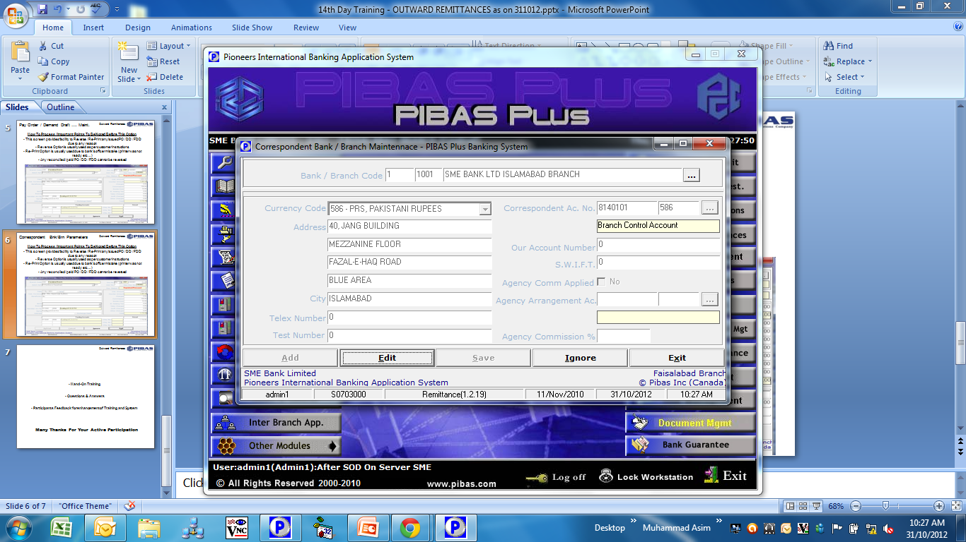
Outward Remittances
Correspondent Bnk/Brn Parameters
How To Process / Important Points To Be Noted Before This Option
This option is used to Add / Amend any Bank / Branch Parameters e.g. Code, Currency, Correspondent Account Number, Address etc.

Slide 7
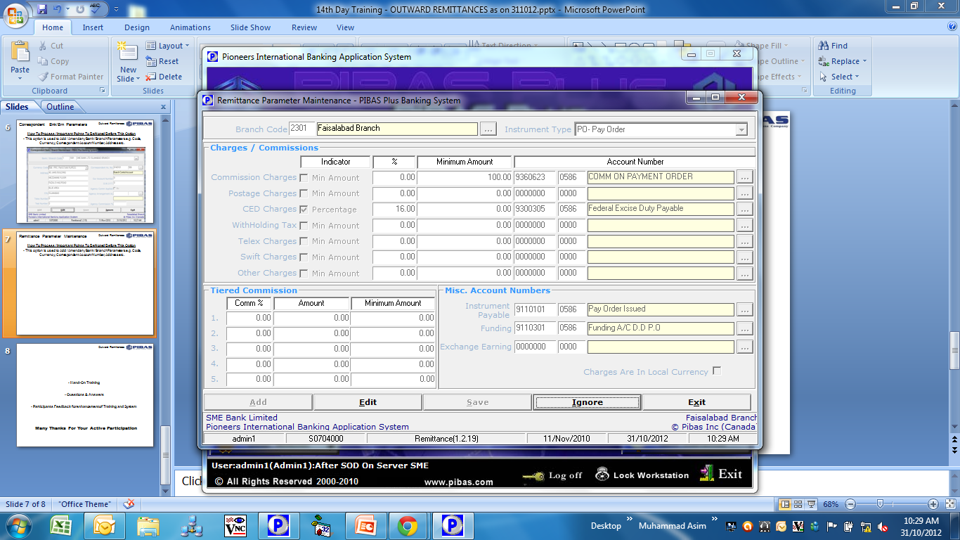
Outward Remittances
Remittance Parameter Maintenance
How To Process / Important Points To Be Noted Before This Option
This option is used to Add / Amend Pay Order / Demand Draft Parameters e.g. Funding Accounts, Commission Accounts and other Government Taxes etc.

Slide 8
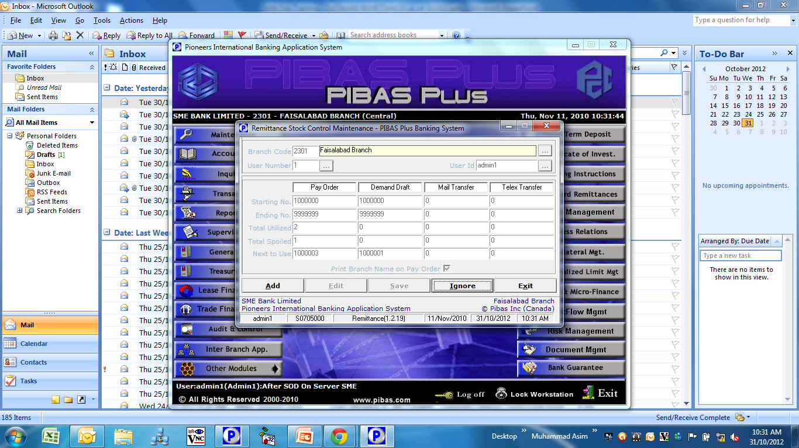
Outward Remittances
Remittance Stock Control Maint.
How To Process / Important Points To Be Noted Before This Option
This option is used to Add / Amend Pay Order / Demand Draft Stock Control Parameters i.e. User Number, User ID, PO/DD starting numbers, ending numbers and next to use etc.

Slide 9
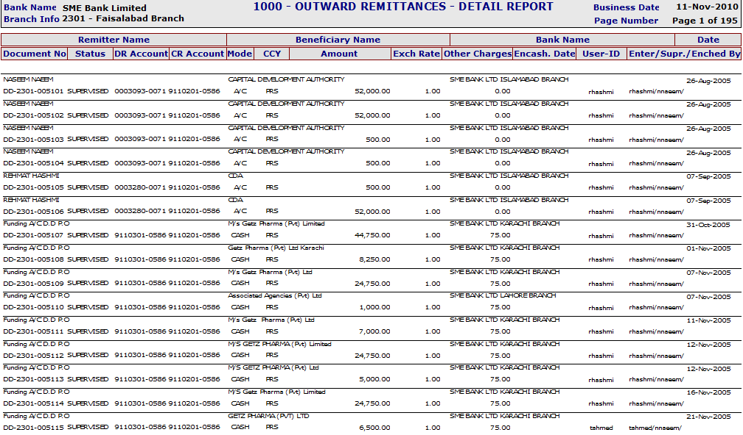
Outward Remittances
Remittance Period Wise Report
How To Process / Important Points To Be Noted Before This Option
This report provides a comprehensive information regarding outward remittances

Slide 10
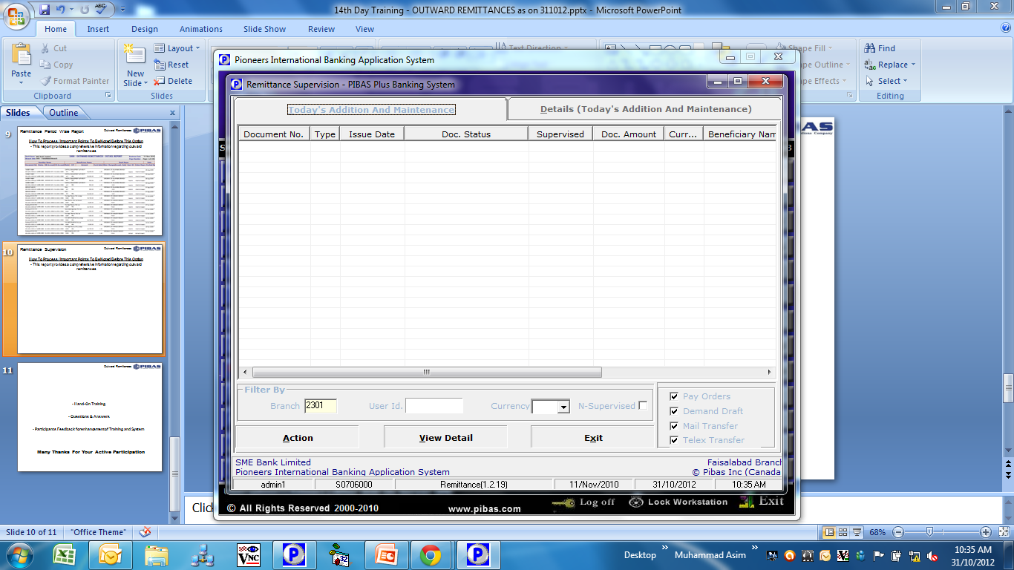
Outward Remittances
Remittance Supervision
How To Process / Important Points To Be Noted Before This Option
In this option a supervisor should take extra care, as Pay Order / Demand Drafts are printed at Supervision Level
Printer should be ready so that re-printing etc. could be avoided

Slide 11
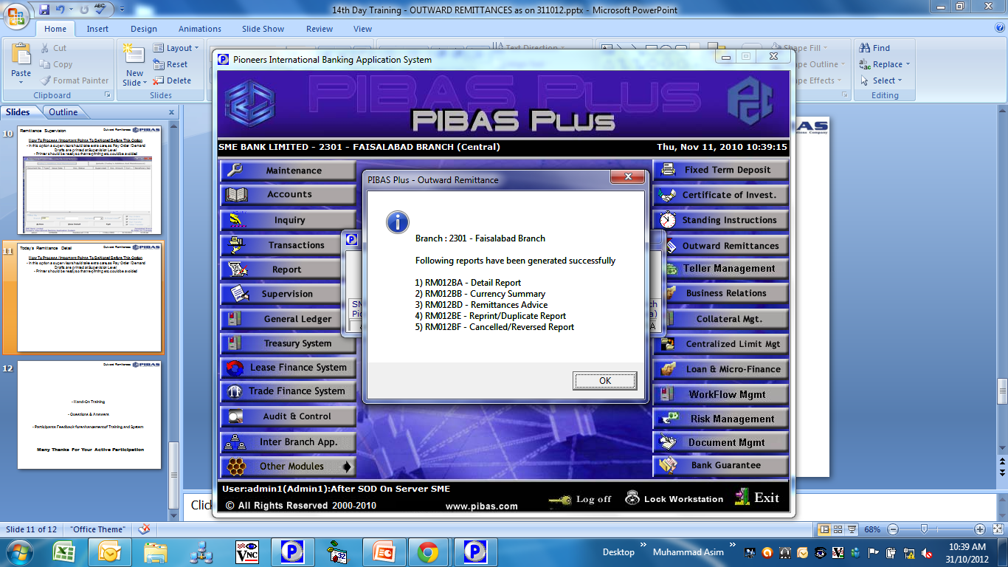
Outward Remittances
Today’s Remittance Detail
How To Process / Important Points To Be Noted Before This Option
Through this option Five Reports are generated that can be viewed on PIBAS Report Viewer

Slide 12
Outward Remittances
Hand-On Training
Questions & Answers
Participants Feedback for enhancement of Training and System
Many Thanks For Your Active Participation

